Slide 1
A Quanta of Cryptography
By Samuel Crawford Loveys

Slide 2
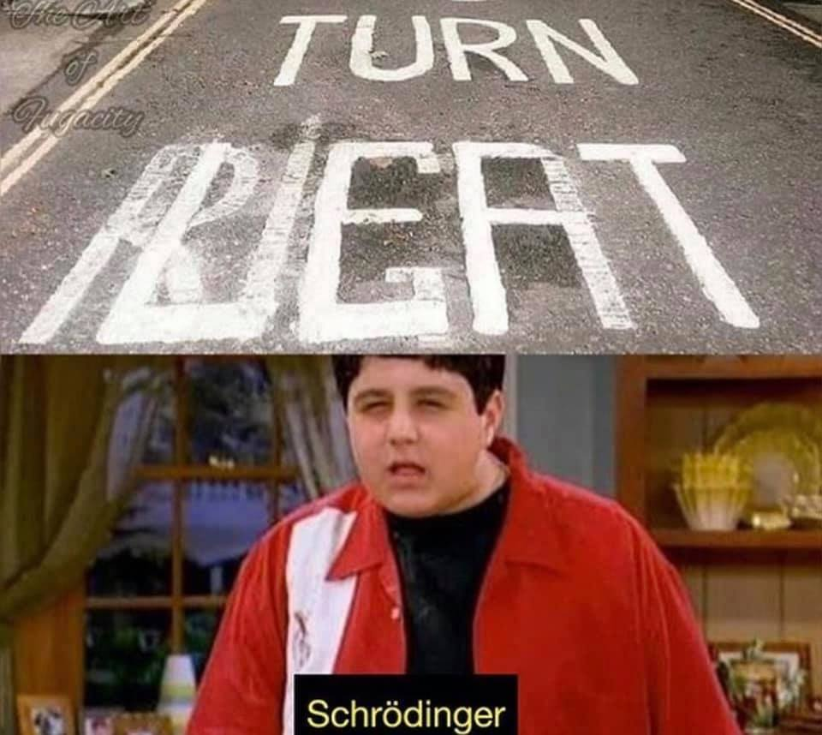
Takeaways
Understanding sophisticated attacks from quantum computers
Hard counters
Private-key cryptography
Quantum key generation
How to mitigate damage from these attacks
Resource exhaustion
Quantum-resistant cryptography

Slide 3
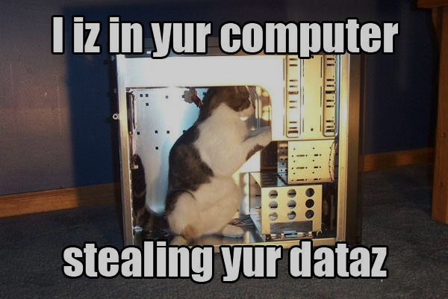
Sophisticated Quantum Attacks
Let’s refer to sophisticated attacks as reductions from decrypting a message into a problem with an efficient solution
Usually computer attacks target
Bugs, exploits or otherwise bad implementations
Quantum computers have efficient solutions to
Integer Factorization problem
Discrete Logarithm problem
Elliptic-Curve Discrete Logarithm problem

Slide 4
Shor’s Algorithm for Prime Factorization
Involves Reducing the Factorization problem into the Order-Finding problem
Completes in polynomial time with size of integer being factored
However, to date the largest number factored on a quantum computer with Shor’s algorithm is 21

Slide 5
Quantum-Resistant Cryptography
No classical solution provides a guarantee of security
National Institute of Standards and Technology (U.S.A.) gave some suggestions in the Report on Post-Quantum Cryptography (2016)
Lattice-based cryptography
Code-based cryptography
Multivariate polynomial cryptography
Hash-based signatures
Proposed solutions not as functional as what we use today

Slide 6
Quantum Key Generation
Generates a private key between two parties Alice and Bob
Occurs over a public classical network and a public quantum network
Always results in one of two outcomes:
Alice & Bob both know that they have the same key and no one else has it
Alice & Bob both know that the key generation has failed
Has been demonstrated via fiber-optics and via laser connections to satellites

Slide 7

Summary
Classical public/symmetric key cryptography
Some implementations no longer secure
Others might work given higher levels of security
Will not be as cheap as it is today
Private key cryptography
Is perfectly secure but very expensive
Can be aided by Quantum Key Generation

